Slide 1
OBJECT-ORIENTED PROGRAMMING (OOP)
Week – 01
Lecturer:Sobia Iftikhar
sobia.iftikhar@nu.edu.pk

Slide 2
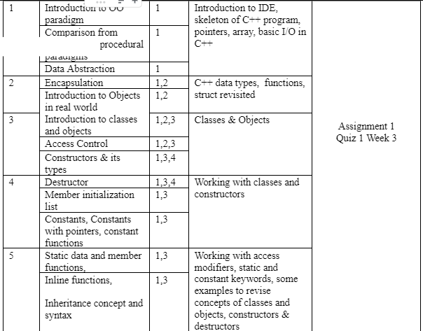
Course Outline

Slide 3
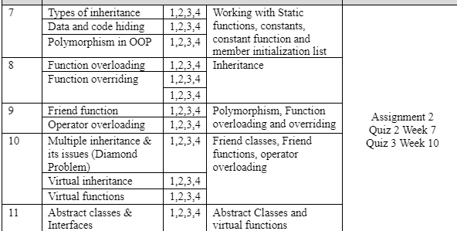
Course Outline

Slide 4
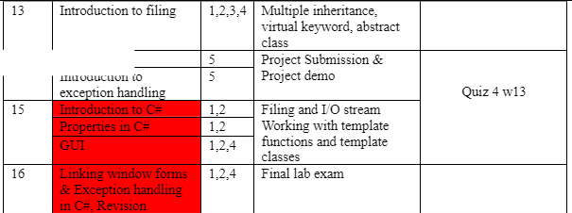
Course Outline

Slide 5
Books
Textbook:
"Problem Solving with C++", 9e Global Edition, Walter Savitch ISBN-13:9781292018249, Addison-Wesley, 2015.
C++ How to program By Deitel & Deitel.
Reference books:
The C++ Programming Language by Bjarne Stroustrup.
Object Oriented Software Engineering by Jacobson.
C# 4.0: The Complete Reference by Herbert Schildt

Slide 6
Marks Distribution (Assessments / Grading)
Mid - 30 wtg
Assignment - 10 wtg
Quiz - 10 wtg
Final - 50

Slide 7
Week one – Class One

Slide 8
What Are the Types of Programming Languages
Programming languages allow programmers to code software.
First Generation Languages
Second Generation Languages
Third Generation Languages
Fourth Generation Languages
Fifth Generation Languages

Slide 9
First Generation Languages
These are low-level languages like machine language.
Machine language
Operation code – such as addition or subtraction.
Operands – that identify the data to be processed.
Machine language is machine dependent as it is the only language the computer can understand.
Very efficient code but very difficult to write.

Slide 10
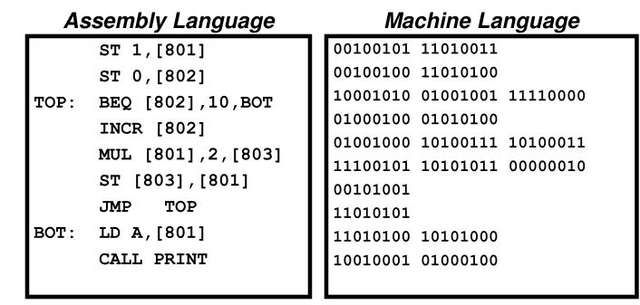
Second Generation Languages
Assembly languages
Symbolic operation codes replaced binary operation codes.
Assembly language programs needed to be “assembled” for execution by the computer. Each assembly language instruction is translated into one machine language instruction.
Very efficient code and easier to write.
These are low-level assembly languages
used in kernels and hardware drives.

Slide 11
Third Generation Languages
High Level Languages
Closer to English but included simple mathematical notation.
Programs written in source code which must be translated into machine language programs called object code.
The translation of source code to object code is accomplished by a machine language system program called a compiler.

Slide 12
Third Generation Languages (cont’d.)
Alternative to compilation is interpretation which is accomplished by a system program called an interpreter.
Common third generation languages
FORTRAN
COBOL
C and C++
Visual Basic

Slide 13
Fourth Generation Languages
Event based programming
A high level language (4GL) that requires fewer instructions to accomplish a task than a third generation language.
Used with databases
Query languages
Report generators
Forms designers
Application generators

Slide 14
Fifth Generation Languages
Artificial Intelligence
Machines that can think like humans
Machines that takes its own decisions
These languages can be used to query the database in a fast and efficient manner.
In this generation of language, the user can communicate with the computer system in a simple and an easy manner.

Slide 15
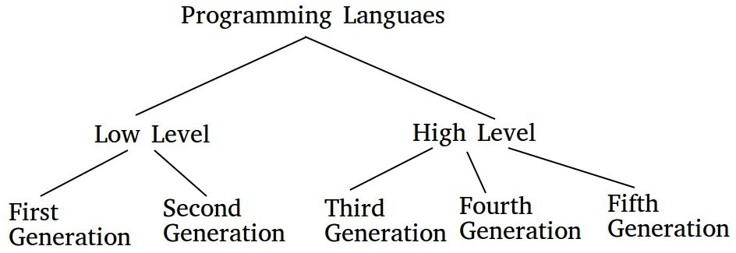
The first two generations are called low level languages. The next three generations are called high level languages.

Slide 16
The C++ language features most directly support four programming styles
Procedural programming
Data abstraction
OOP programming
Generic programming
PP can be defined as a programming model which is derived from structured programming, based upon the concept of calling procedure. Procedures, also known as routines, subroutines or functions
This is programming focused on the design of interfaces, hiding implementation details in general and representations
OOP can be defined as a programming model which is based upon the concept of objects
This is programming focused on the design, implementation, and use
of general algorithms.

Slide 17
Agenda
What is programing Paradigm?
What is POP
What is OOP
Languages for OOP & POP
POP vs OOP

Slide 18
What is POP
A procedural language is a sort of computer programming language that has a set of functions, instructions, and statements that must be executed in a certain order to accomplish a job or program.
Procedural languages include BASIC, C, FORTRAN, Java, and Pascal, to name a few.
features:
Modularity
Predefined Function
Scoping
Advantages
portable
Function
Flow Tracking
Disadvantages
large scale
not work for real world problem
Data Security

Slide 19
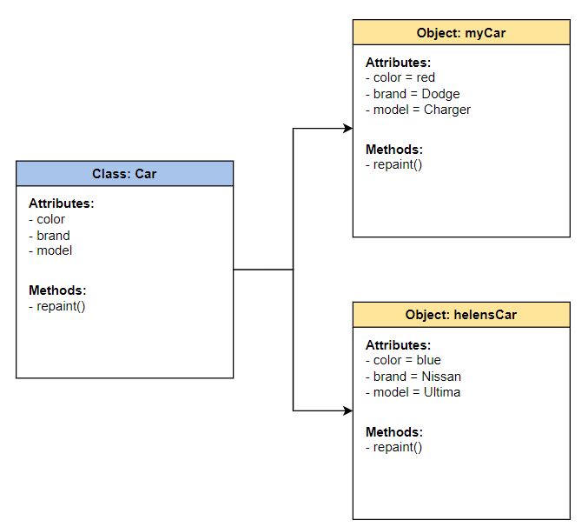
let’s talk about OOP
Object-Oriented Programming (OOP) is a programming paradigm in computer science that relies on the concept of classes and objects.
It is used to structure a software program into simple, reusable pieces of code blueprints (usually called classes),
which are used to create individual instances of objects.

Slide 20
Basic Concepts of Object Oriented Programming
It is necessary to understand some of the concepts used extensively in object-oriented programming. These include:
Objects
Classes
Data abstraction and encapsulation
Inheritance
Polymorphism
Dynamic binding
Message passing

Slide 21
What is object-oriented programming?
There are four features of object-oriented programming to know:
Encapsulation
Abstraction
Inheritance
Polymorphism

Slide 22
Inheritance
Inheritance is a features of OOP which allow the user to inherit the common properties from other class
For example, Class Vehicle and class bike and Class car
Types of inheritance:
Single
Multiple
Multivel
Hierarchical
Hybrid

Slide 23
Polymorphism
https://www.phptutorial.net/php-oop/php-polymorphism/
polymorphism refers to ability to exist in multiple form. Multiple interface can be given to a single interface
For example: First, define an abstract class named Person that has an abstract method called greet().
Type f Polymorphism:
Static / Compile time ( Overloading)
Dynamic/ Run time (Overriding)

Slide 24
Encapsulation
Encapsulation refers to binding the data and code that works on together in single unit.
For example: we have a class named as car and we have all the member functions and member variables wrapped inside this single unit and this binding of data is known as encapsulation.
Access Modifier:
Public
Private
Protected

Slide 25
Abstraction
Abstraction concept only allowing to display the important information and hide the implementation details from user.
Achieve by:
Abstract Class
Abstract Method

Slide 26
Real-life Example
We can take a real-life example of an Air conditioner (AC).
We have a remote control in order to control the various AC functions like start, stop, increase/decrease the temperature, control humidity, etc.
We can control these functions just with a clock of a button but internally there is a complex logic that is implemented to perform these functions.

Slide 27

Data Abstraction (Example)

Slide 28
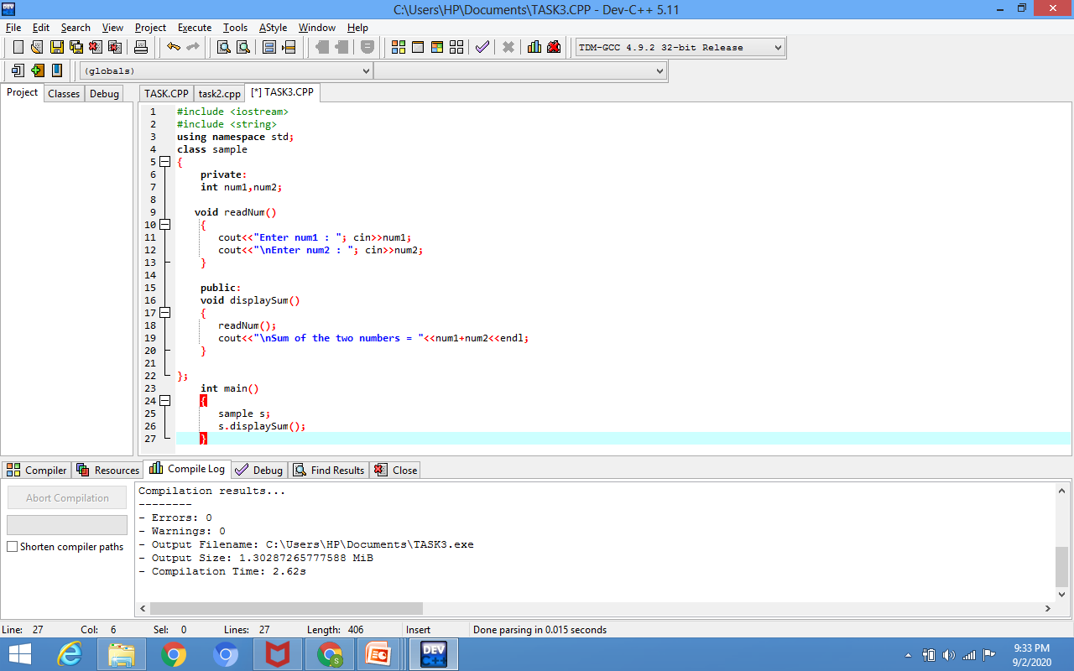
Example-Data Abstraction

Slide 29
Advantages of Information Hiding
Simplifies the model by hiding implementation details
Prevents accidental access
Prevents illegal access or manipulation

Slide 30
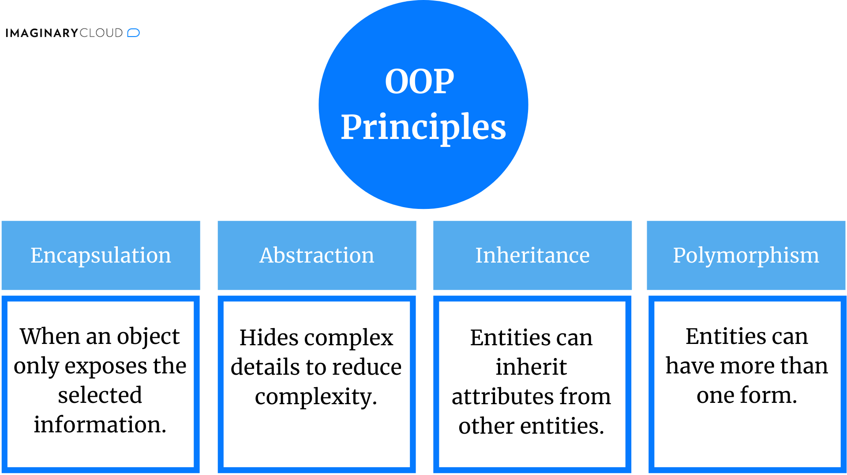

Slide 31
Procedural vs OOP
Flexibility
Object-oriented programming provides flexibility for your codebase through inheritance and polymorphism. Classes and objects (depending on the language) can also share properties and methods through inheritance. The child class or object inherits everything from its parent. When a child redefines something inherited from a parent, it is polymorphism.
Example: If you have an object called vehicle with a property of number of wheels and a method called drive, then you could create a child object called motorcycle. motorcycle would inherit drive and number of wheels, but you could update number of wheels to have a value of “2." If you ever update the method called drive on the vehicle object, then every child object (like motorcycle, scooter, or bus) would have the new drive method.

Slide 32
Class
A class in C++ can be viewed as a blueprint or a skeleton of a particular entity. Class is a user-defined data type. It contains the general information or data for that particular entity and the functions that operate on that entity.
In C++ syntax, we define a class with keyword “class” followed by the name of the class.
The class name is followed by the details of the class enclosed in curly braces and is terminated by a semicolon.

Slide 33
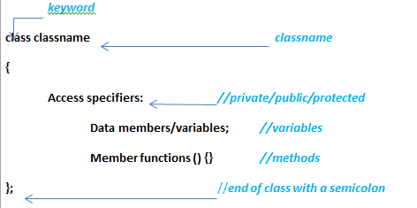
Syntax of Class

Slide 34
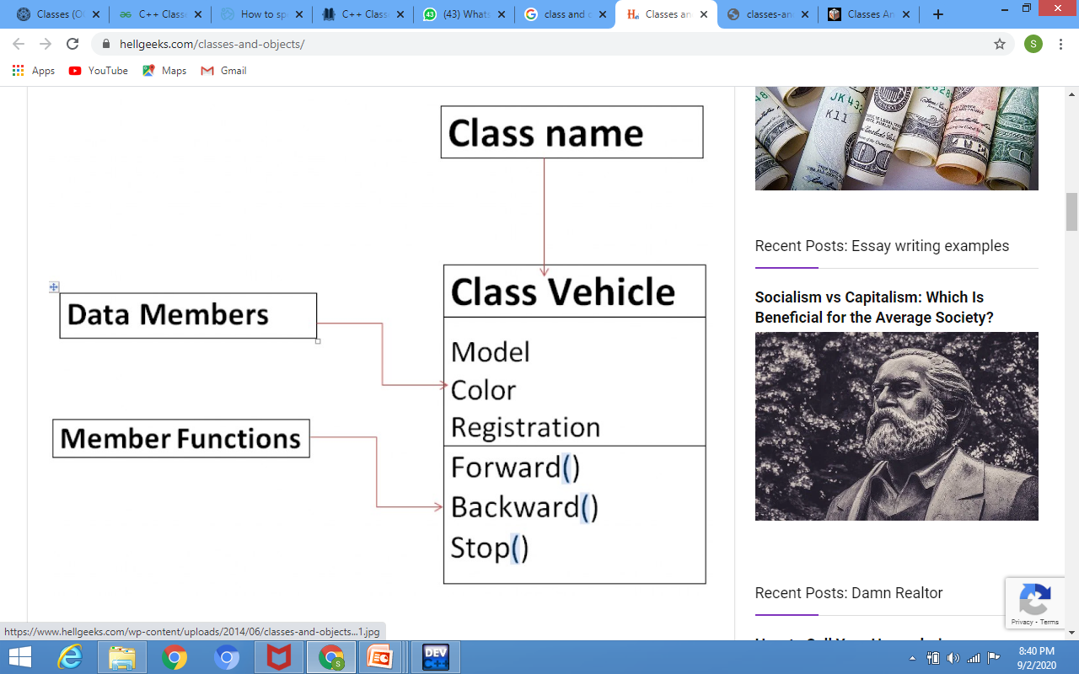
Example-Class

Slide 35
Specification of Class
Class: Keyword
Class-name: User define
Access Specifiers: Public, Private, Protected
Data members: Data members are the data variables
Member Function: Member functions define the operations on data members.

Slide 36
Access Specifiers
class MyClass { public: // Public access specifier int x; // Public attribute private: // Private access specifier int y; // Private attribute }; int main() { MyClass myObj; myObj.x = 25; // Allowed (public) myObj.y = 50; // Not allowed (private) return 0; }
The class members that have been declared as private can be accessed only from within the class. This facilitates data hiding which is also one of the key features of object-oriented programming.
The class members that has been declared as protected are accessible within the class and also in the derived class.
Public members can be accessed from outside of class as we
OutPut
error: y is private

Slide 37
Objects
In order to use the class functionality, we need to instantiate the class to create an object. An object is an instance of a class. I simple words, we can say that an object is a variable of type class.
classname object name;
Once the object is created, it can be used to access the data members and functions of that class.

Slide 38
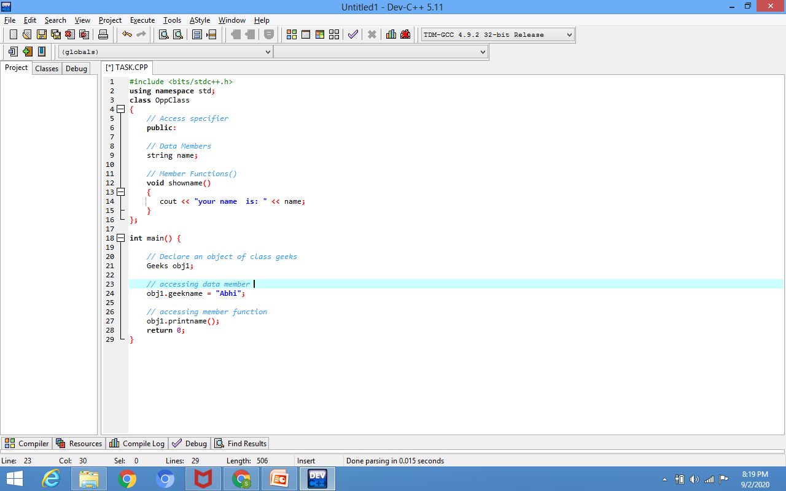
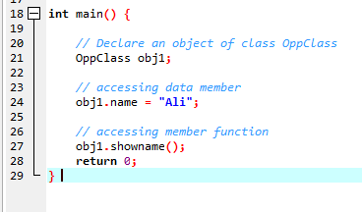
Syntax of Class and Object

Slide 39
Example-Student Info
Write Code that take input from user student-id , student-age , student-name and print all information.
Hint: Two method will be declare

Slide 40
Sructure
structure is another user defined data type available in C/C++ that allows to combine data items of different kinds.
Structures are used to represent a record. Suppose you want to keep track of your books in a library. You might want to track the following attributes about each book −
Title
Author
Subject
Book ID

Slide 41
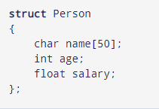
Syntax of structure
The struct keyword defines a structure type followed by an identifier (name of the structure).
Then inside the curly braces, you can declare one or more members (declare variables inside curly braces) of that structure.
For example:

Slide 42
C Structure vs C++ Structure
1. Member functions inside structure:
Structures in C cannot have member functions inside structure but Structures in C++ can have member functions along with data members.
struct person_str {
string name; int age; //constructor person_str() {
name = "default";
age = 77;}

Slide 43
C Structure vs C++ Structure
2. Direct Initialization:
We cannot directly initialize structure data members in C but we can do it in C++
#include <stdio.h>
struct Record {
int x = 7;
};
// Driver Program
int main()
{
struct Record s;
printf("%d", s.x);
return 0;
}
/* Output : Compiler Error
6:8: error: expected ':', ', ', ';', '}' or
'__attribute__' before '=' token
int x = 7;
^
In function 'main': */

Slide 44
C Structure vs C++ Structure
3. Using struct keyword:
In C, we need to use struct to declare a struct variable. In C++, struct is not necessary. For example, let there be a structure for Record. In C, we must use “struct Record” for Record variables. In C++, we need not use struct and using ‘Record‘ only would work.
#include <iostream>
using namespace std;
struct Record {
int x = 7;
};
// Driver Program
int main()
{
Record s;
cout << s.x << endl;
return 0;
}
struct Record {
int x = 7;
};
// Driver Program
int main()
{
struct Record s;
printf("%d", s.x);
return 0;
}

Slide 45
C Structure vs C++ Structure
4. Static Members: C structures cannot have static members but is allowed in C++.
5. Access Modifiers: C structures do not have access modifiers as these modifiers are not supported by the language. C++ structures can have this concept as it is inbuilt in the language.
6. Constructor creation in structure: Structures in C cannot have constructor inside structure but Structures in C++ can have Constructor creation.

Slide 46
Structure vs Classes
In C++, a structure is the same as a class except for a few differences.
The most important of them is security.
A Structure is not secure and cannot hide its implementation details from the end user while a class is secure and can hide its programming and designing details.
Following are the points that expound on this difference:
What if we forget to put an access modifier before the first field?
1) Data Members of a class are private by default and members of a struct are public by default.
struct Robot { OR class Robot {
float locX; float locX;

Slide 47
Structure vs Classes
Class
Structure
Classes are of reference types. | Structs are of value types.
All the reference types are allocated on heap memory. | All the value types are allocated on stack memory.
Class has limitless features. | Struct has limited features.
Class is generally used in large programs. | Struct are used in small programs.
A Class can inherit from another class. | A Struct is not allowed to inherit from another struct or class.

Slide 48
Class Methods
Methods are functions that belongs to the class.
There are two ways to define functions that belongs to a class:
Inside class definition
Outside class definition

Slide 49
Inside Example
class MyClass { // The class public: // Access specifier void myMethod() { // Method/function defined inside the class cout << "Hello World!"; } }; int main() { MyClass myObj; // Create an object of MyClass myObj.myMethod(); // Call the method return 0; }

Slide 50
Outside Example
To define a function outside the class definition, you have to declare it inside the class and then define it outside of the class. This is done by specifiying the name of the class, followed the scope resolution :: operator, followed by the name of the function:
class MyClass { // The class public: // Access specifier void myMethod(); // Method/function declaration }; // Method/function definition outside the class void MyClass::myMethod() { cout << "Hello World!"; } int main() { MyClass myObj; // Create an object of MyClass myObj.myMethod(); // Call the method return 0; }

Slide 51
Class Outside Example-Parameter
#include <iostream> using namespace std; class Car { public: int speed(int maxSpeed); }; int Car::speed(int maxSpeed) { return maxSpeed; } int main() { Car myObj; // Create an object of Car cout << myObj.speed(200); // Call the method with an argument return 0; }

Slide 52
Multiple Objects
You can create multiple objects of one class.
The benefit of multiple instances of a single class is that each of them can hold different values to their variables, and the methods only affect that specific object, so each of them have the same skeleton, but are in independent states.
An example of this is an enemy class in a game. If you have multiple enemies, you can create multiple instances of a class, where each enemy is an instance. They all may be in a different position, which could be a private variable of the class.

Slide 53
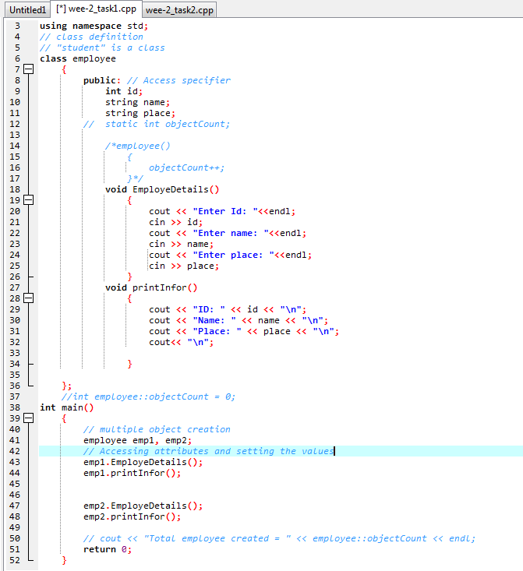
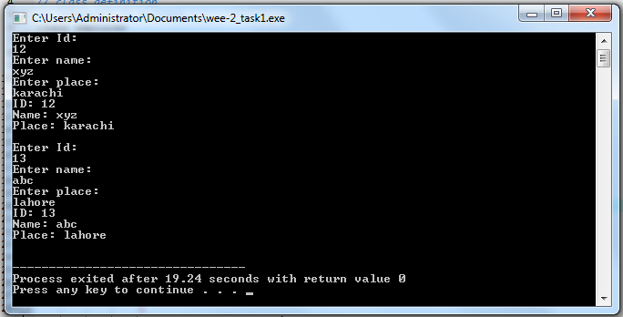
Introduction To Multiple Objects Into Real World

Slide 54
Introduction To Objects Into Real World
Object
instance of class
State of an object
Static and Dynamic
Behavior of an object
Behavior is how an object acts & reacts, in terms of its state change and message passing.
Identity of an object
Employee - Empid, Name, Gender, Mobile_No
Responsibility of an object
Responsibility of an object is the role it serves within the system.

